Slide 1
Welcome to Year 4! Nightingales: Mrs Dervish and Mrs Chivers TAs: Mrs Pruden, Mrs Khan Swifts: Mrs Rickcord, Miss Lang (Friday) TAs: Mrs Stock, Mrs Leech and Mrs Pacey PPA cover: Mr Pauley, Mrs Irwin

Slide 2
A Typical day
Time | Lesson
8.45-9.10 | Registration and morning work (please arrive as close to 8.45 as possible)
9.10-9.30 | Whole Class Reading /Spelling/handwriting/
9.30-10.30 | English
10.30-10.50 | Assembly
10.50-11.10 | Playtime
11.10-12.15 | Maths
12.15-1.15 | Lunch time
1.15-2.50 | Topic/Art/ Science/PSHE/ PE/RE/French/Music
2.50-3.15 | Story time/Assembly
3.20 | Home time

Slide 3
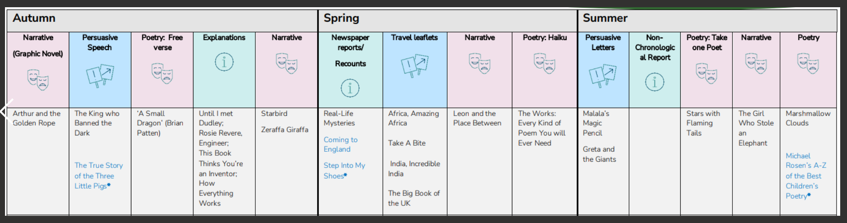
English

Slide 4
English
Grammar
Accurate punctuation, including direct speech
Organising text into paragraphs
Comma use
Apostrophes (possessive and for contraction)
Spellings
Continuing to develop phonic knowledge where appropriate
Looking at different ways of spelling the same sound
Homophones and near-homophones
Developing knowledge of prefixes and suffixes
Forming adverbs
Irregular plurals
Unsounded syllables
Year 3/4 statutory spellings
Handwriting
Cursive letter join, finger spaces

Slide 5
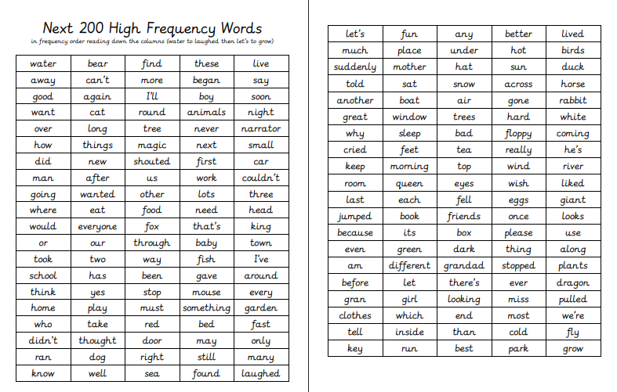

Slide 6
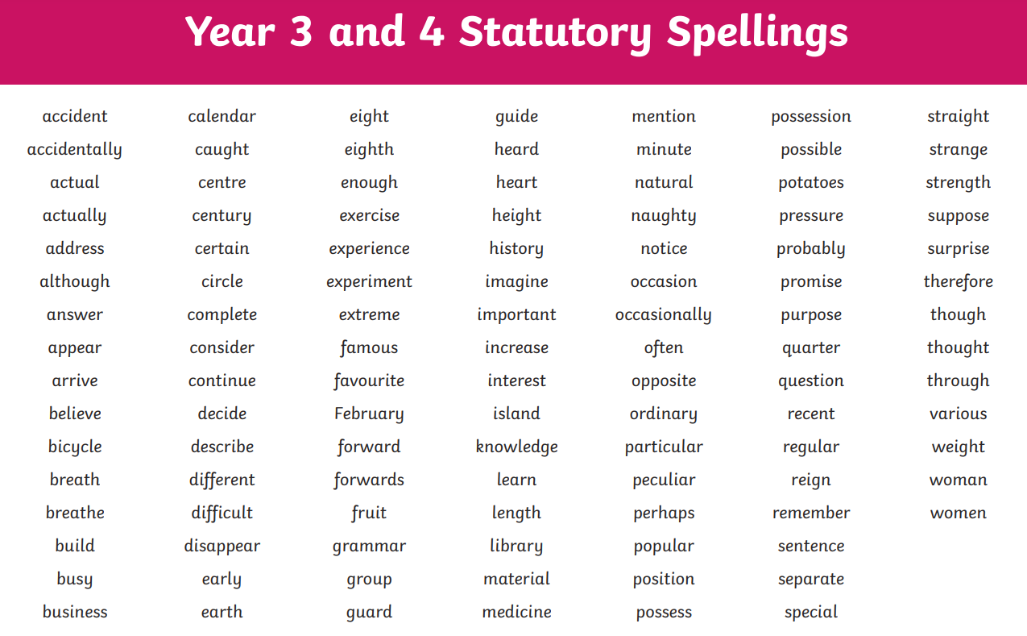

Slide 7
Reading
Developing positive attitudes to reading and an understanding of what they read.
Read as much as possible and in many different ways! Please encourage them to sign their reading records.
Donations of children’s comics, magazines and newspapers to enhance class libraries greatly appreciated!
Discussing the author’s words and phrases that capture the reader’s interest and imagination.
Learning to “read between the lines”, i.e. what does the author show us rather than tell us?
Volunteers welcomed for running the class sessions in the library and hearing readers.
Parents looking for ideas of books their children might enjoy should visit www.booktrust.org.uk
For developing comprehension skills, parents can visit home.oxfordowl.co.uk

Slide 8
Reading opportunities in school include:
Listening to the class story
Whole class reading
Daily independent reading and follow up quizzes (school banded or home book)
1 to 1 reading as required
Visits to the school library

Slide 9
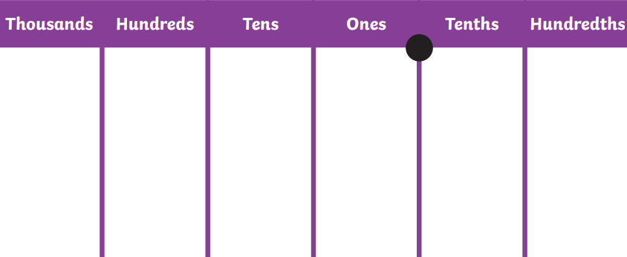
Maths

Slide 10
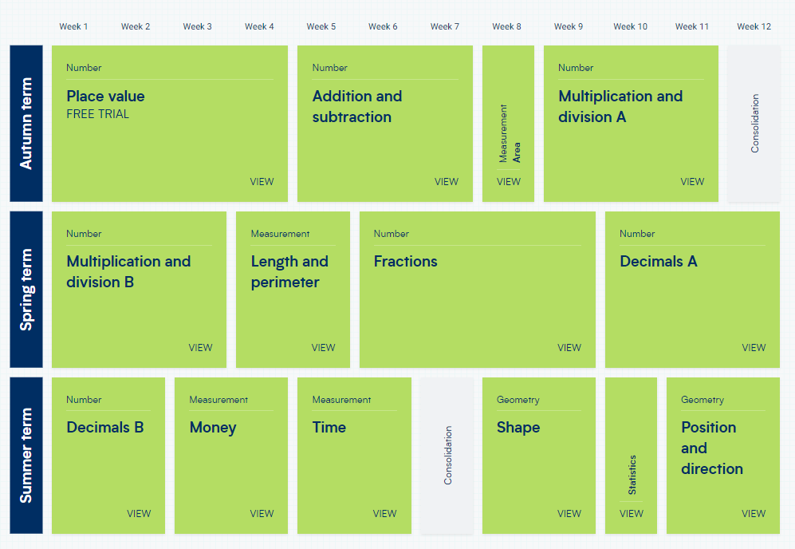
White Rose maths.

Slide 11
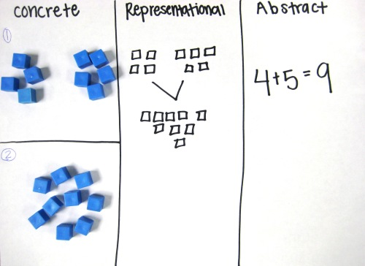

Slide 12
Multiplication Tables Check June 2026
Online test taken by all year 4s across the country
25 questions on the tables 2-12
6 seconds to answer each question
https://mathsframe.co.uk/en/resources/resource/477
https://www.purplemash.com/#app/games/timestables_assessment
https://ttrockstars.com/
https://www.topmarks.co.uk/maths-games/hit-the-button

Slide 13
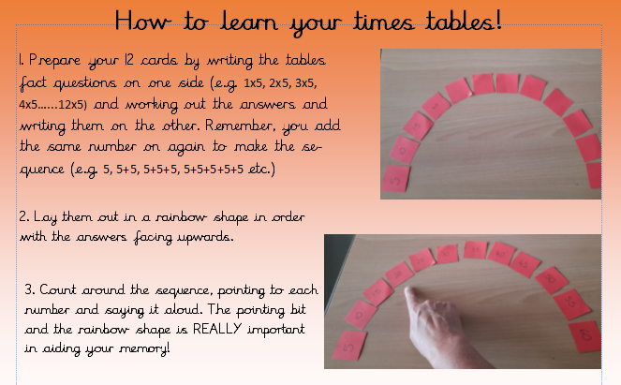
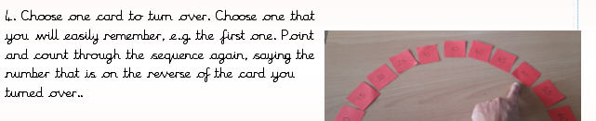

Slide 14
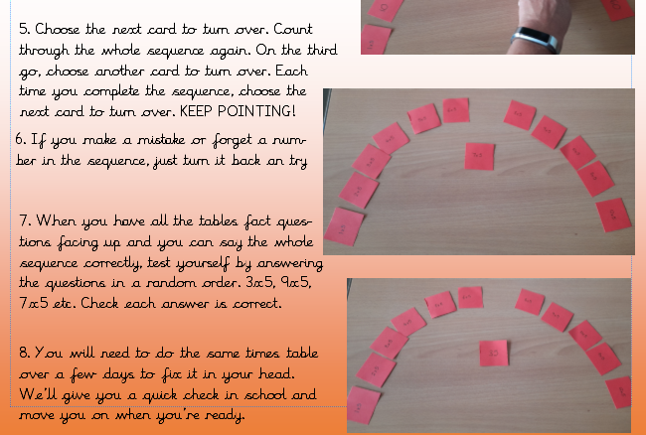

Slide 15
Geography & History
Science
AUTUMN
Ancient Maya
Where does our food come from?
AUTUMN
Electricity
States of Matter
SPRING
Sound
SPRING
Anglo Saxons
Rainforests
SUMMER
Animals including Humans
Characteristics of living things
SUMMER
Tudors & Victorians
Rivers
If you think you would be able to come in to do a class talk linked to any of these areas, please fill in on the sign up sheet.

Slide 16
Art and D&T/ PSHE/French/Computing/RE/Music
Drawing, painting, cooking, mechanisms, structures, craft & design.
PSHE: Citizenship, rights and responsibilities, relationships, emotions, anti-bullying week, diversity, community, healthy and safe lifestyles, SRE
French: I Am Able to, Phonics, Vegetables, Presenting Myself, In the Classroom
Computing: online safety, coding, word processing, using search engines
RE: Islam, Sikhism, Places of Worship.
Music: recorders, glockenspiel, singing, composition
If you think you would be able to come in to do a class talk linked to any of these areas, please fill in on the sign up sheet.

Slide 17
P.E
Our PE days are Mondays and Tuesdays.
Children should come to school in their PE kit on those days
A reminder of the expectation for PE kit from our policy:
· School blue or white T-shirt and shorts
· Long hair needs to be tied back.
· All jewellery should be removed.
· For outdoor games in winter, children should wear a pair of jogging bottoms or leggings and a fleece or sports sweater or school jumper. Children will be permitted to wear additional clothing on especially cold or rainy days to encourage an ‘all weathers’ approach to exercise.
We ask that all clothing should be in school colours: blue, grey, black, white.
Football strips and clothes with large logos or slogans are not appropriate.

Slide 18
Assessment
GDS: Working at greater depth within the expected standard for the year group objectives
EXS: Working at the expected standard
WTS: Working towards the expected standard
B: Working below the expected standard
PKS: used to assess all pupils working below the level of the national curriculum but who are engaged in subject-specific learning.

Slide 19
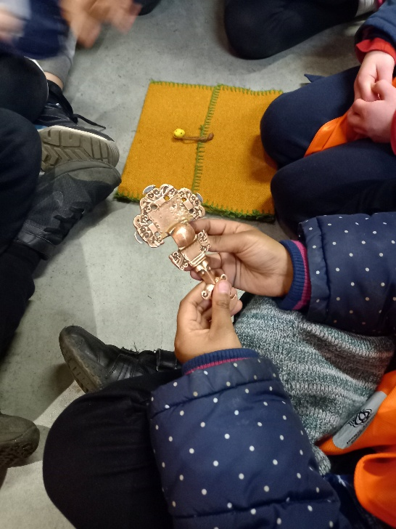
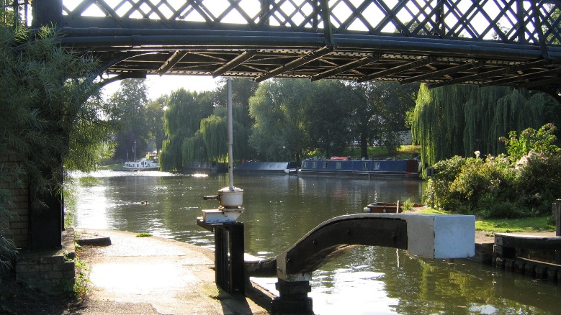

Trips & Visitors
West Stow
Walk along the river & Museum Trip
Ancient Maya Day

Slide 20
Home Learning
Read a wide range of texts and discuss them
To practise times tables
Spelling practice (set on Fridays) Please take time to look at their spelling dictation book which is sent home.
Weekly Mathletics (set on Fridays)
Topic menu tasks x 3
NB where tasks are online, please be aware of what your child is doing and ask us for advice on how best to protect your child. For example, adding parental controls in settings.

Slide 21

Who we are
FABS (Friends At Bellbird School) is the PTA at The Bellbird, and is run by a small number of dedicated parent volunteers.
What we do
Last year we have raised over £9,500 from our events, including the Christmas and Summer Fairs, school discos and quiz nights, and we donated over £14,500 to fund the purchase of 32 new Chromebooks to support the delivery of the IT curriculum, to provide swimming lessons, a whole school pantomime and paid for a re-stock of the school library and new star reader books.
We need your help!
We are always looking for new parents who want to get involved, please do get in touch on bellbirdpta@gmail.com.

