Slide 1
Key Stage 2 SATs meeting

Slide 2






What we will cover:
When are SATS?
What will happen?
Additional time/assistance
Helping your child
Secondary school
Wellbeing

Slide 3
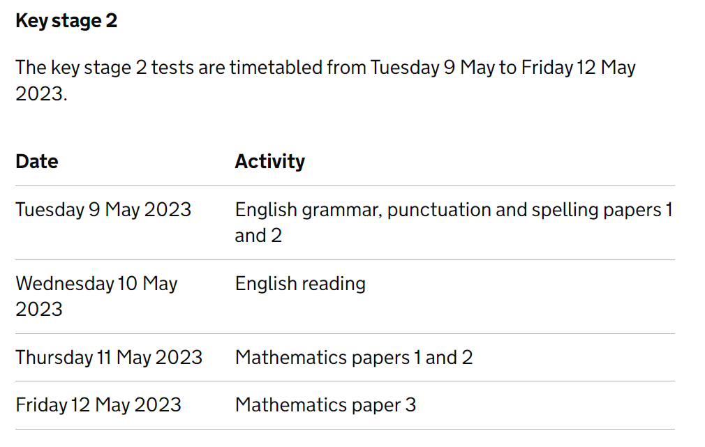
When are the tests?

Slide 4
What will happen?
Held in normal classrooms
Equipment provided
Normal class adults present
Test conditions that we have practised

Slide 5
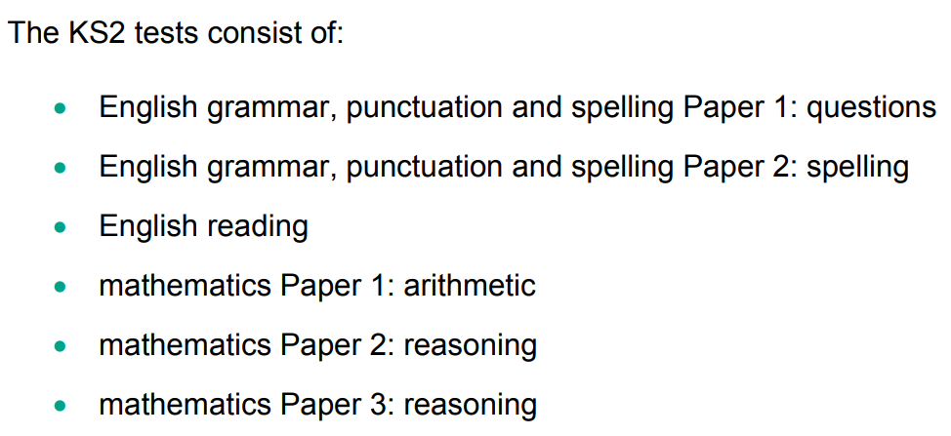
What will happen?

Slide 6
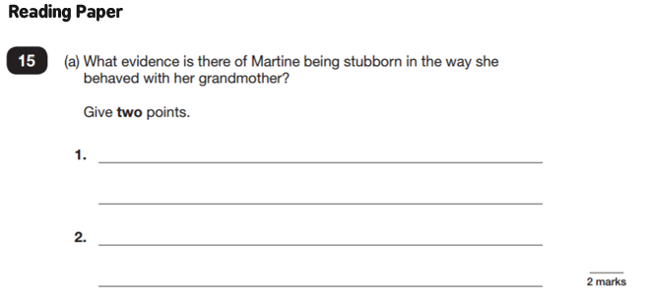
What do SATs look like?

Slide 7
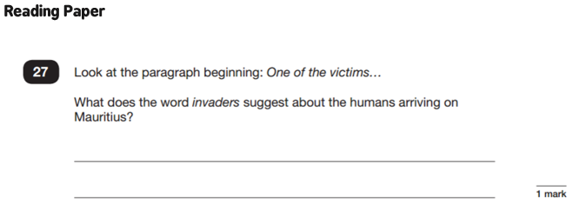
What do SATs look like?

Slide 8
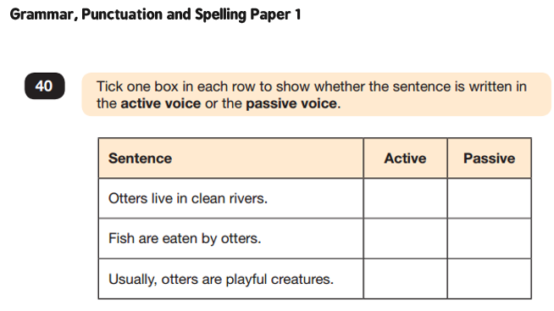
What do SATs look like?

Slide 9
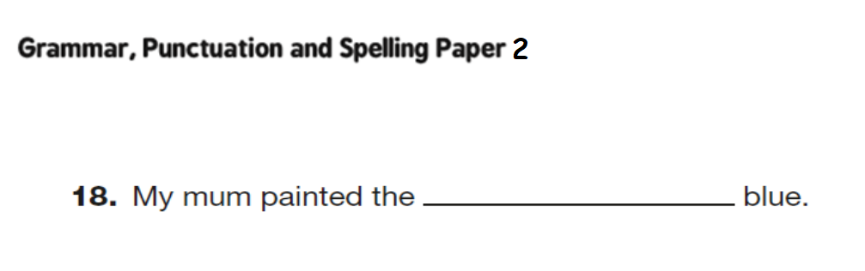
What do SATs look like?

Slide 10
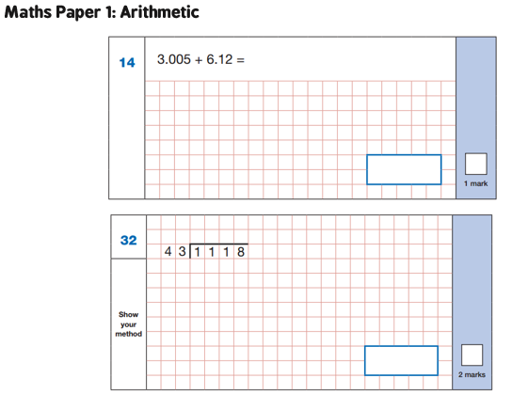
What do SATs look like?

Slide 11
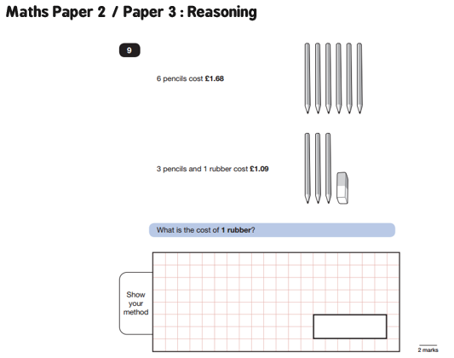
What do SATs look like?

Slide 12
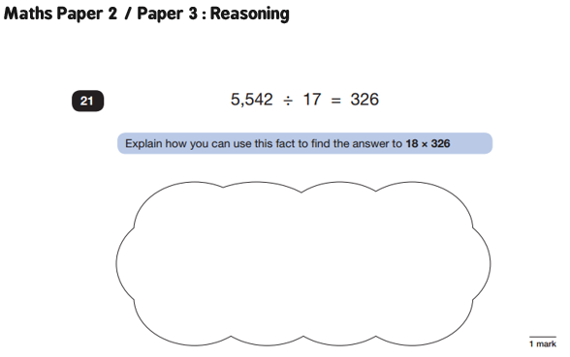
What do SATs look like?

Slide 13
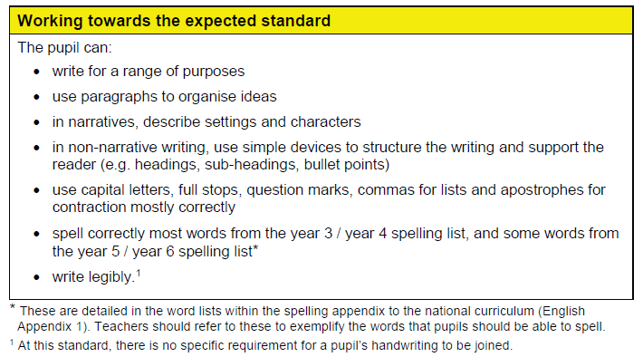
How is writing assessed?
Teacher assessment must show evidence that children meet all these criteria.

Slide 14
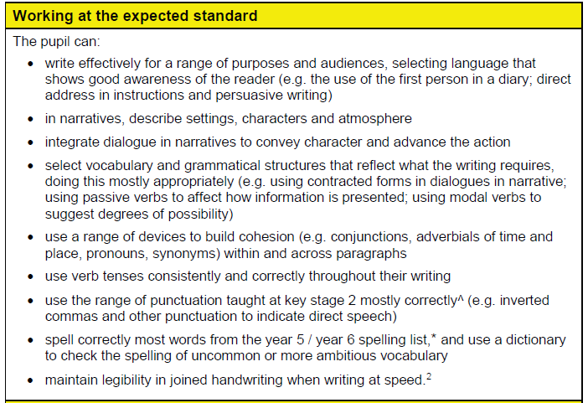
How is writing assessed?
Teacher assessment must show evidence that children meet all these criteria and the ones from the previous level.

Slide 15
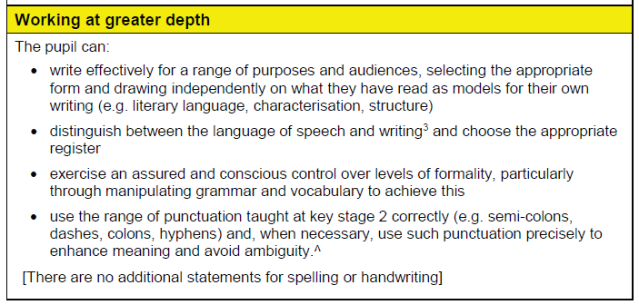
How is writing assessed?

Slide 16
What assistance can my child have?
All questions can be read by adults if children ask
(except in the reading paper)
Some children may be granted additional time/ a reader/ a scribe. This will be discussed with parents on a case by case basis.

Slide 17
Does this make a difference to groupings at secondary school?
Results are passed to secondary schools
Most schools do their own tests in the first year and use this to determine classes
The tests are a measure of the school’s teaching of the National Curriculum in KS2 as a whole

Slide 18
How can I help?
Ensure good sleep (be mindful of the Bank Holiday)
SATS Breakfast club
Talk to them and encourage them
Good attendance
Support with homework
Revision guides such as Letts and CGP SATs busters

Slide 19
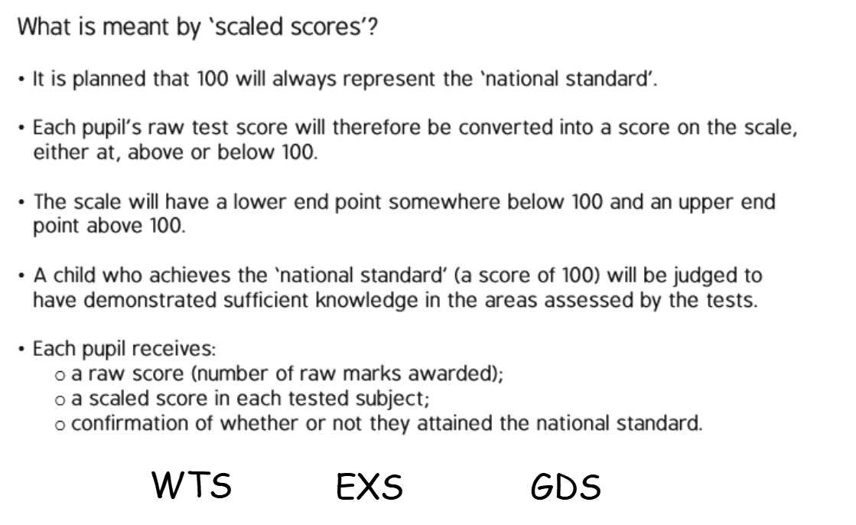
How are results reported?
In the Summer report
(start of July)

Slide 20
How are you supporting wellbeing?
Breakfast club
If your child is ill, they can sit the test another day.
SATs test all knowledge of KS2, not just this year
Children are used to the test style and have lots of strategies if they get stuck.
More relaxed afternoons in the week of tests
Lots to look forward to after SATs week!

Slide 21
DATES FOR THE DIARY
24th April – Swimming lessons start
27th April – Visit from Mr Sutton from SVC – Year 7 Transition
9th May – SATS Week
9th June – Sports Day
12th June - PGL
28th June – Induction Day at SVC
29th June – Induction Evening at SVC
4th and 5th July – Year 6 Show Performance at 6pm
12th July – Year 6 Leavers Assembly

Slide 22
Any questions?

