Slide 1

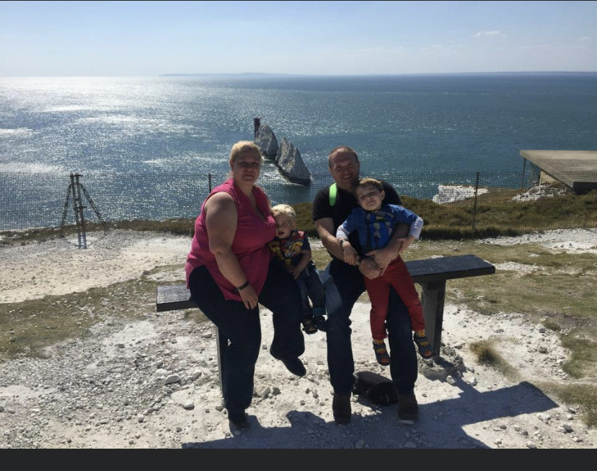
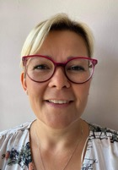
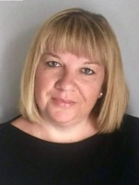
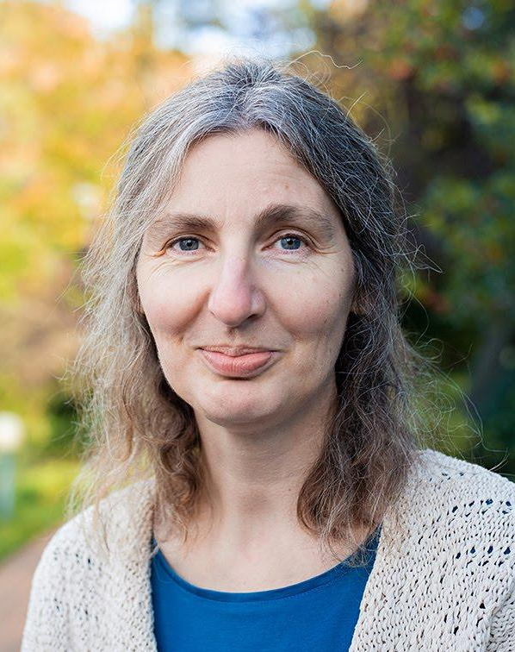
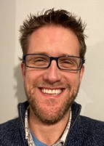
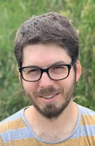
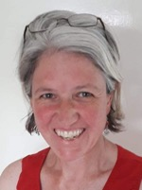
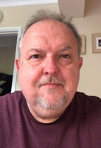
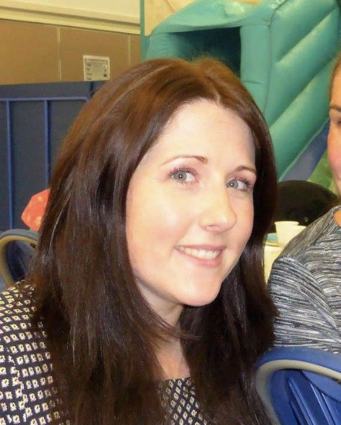

FABS
Friends At Bellbird School
FABS is the Friends, Parents and Teacher organisation (PTA) at the Bellbird School
We are a group of 15 parents and staff with children in all year groups
Here are a few of our faces to look out for at school - please feel free to stop us to ask any questions
Zillah – Quiz mistress extraordinaire
Alison
Emma
Elizabeth
Andy
Alex- Treasurer
Kate
Richard
Louise - Secretary

Slide 2






We run events to bring together the Bellbird children, families, staff and the wider community
During the last two year, unable to run our usual events, we still ran:
a Christmas raffle
Father Christmas visits to children's houses
a quiz
a sunflower growing competition
Visits from the easter bunny
We raise funds to support learning and to purchase resources to benefit all children in the school

Slide 3

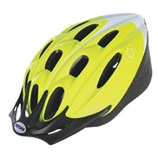
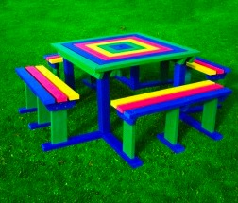
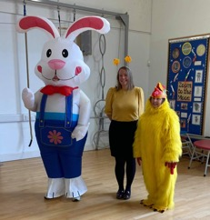
Friends At Bellbird School
In previous years, we have raised in excess of £12,000 p.a.
We have donated money to pay for:
Improving our library – providing books and furniture
Visits from outside theatre companies and authors/poets
Cycle helmets for all new children
Supported building new outdoor play areas
Rainbow playground benches and tables
Swimming lessons for Years 2, 4 and 6
Easter bunny visit - eggs for all children at the school
Christmas presents & crackers for the Christmas lunch
Year 6 Leavers’ gifts and party
Fund for each class teacher for them to buy class resources
Meal vouchers for families during bubble closures

Slide 4
Friends At Bellbird School
We have a great team and supportive parents helping to provide resources and events for Bellbird children!
If you would like to attend our events and help raise funds for the school:
look out for invitations on school comms emails from September
If you would like to find out more about what we do:
Look on the school web page – FABS
www.thebellbird.cambs.sch.uk/friends-at-bellbird-school/
Join our AGM in September
Feel free to stop one of us to ask questions
We welcome all parents wishing to join us in supporting the school
We look forward to welcoming you to the Bellbird!

